Slide 1
Progress Report
November 20, 2023

Slide 2
Project Management

Slide 3
Lillian Greenberg
Frequent Communications with Customer
Emailed back and forth often as the project moves forward with questions and updates
Scheduling Meetings
Upcoming meeting on December 6th
Creation of Presentations
Developed the Slides documents and polished them up
Consolidation of bi-weekly reports
Collected all reports from team leaders and created a condensed version
Discussion with Team Leads
Multiple impromptu meetings with the leads of both teams to determine goals and clarify requirements

Slide 4
R&D + SysOps

Slide 5
Shameer Rao
Azure SQL Database
Expanded on initial schema to capture more relevant data
Created all tables, with rows of test data
Created SQL queries for future functionality (Querying for Most Active Users, Posts from a Specific User, Posts in a date range, etc.)
Next Steps: Verify database web app connection and ensure data is being received
Project Next Steps:
Properly storing different file types (Image and Text currently supported)
Saving and displaying all posts (Posts are only being saved on the localhost)

Slide 6
Jordan Golden
Isolated search features
A function for text search and filter search fits better into django’s views structure
Filter function now handles multiple filters
Search functions now output in JSON format
a lot of the site is using JS to work with google maps
Functions should now be able to be simply plugged into the site
Agnostic to database and website changes

Slide 7
Alexander Stoyanov-Roberts
Split the HTML from one index.HTML file to 4 separate pages to improve workflow (Map.html, about.html, contact.html, signin.html)
Split the JS file from 1 large one that was used for the whole site to a custom JS file that matches the HTML file naming conventions, allowing people to just edit one page of the site.
Changed the homepage of the website the the Map page, and updated the color scheme to better match customer requirements.
Added SMCM branding to the footer and reduced the size of the titles per page.
BUG FIXES: Fixed the bug preventing the widget system from working and the bug preventing the create a post form from closing when you switch tabs.

Slide 8
Matthew Grimelli
Investigated Google Cloud as alternative hosting service
Current decision is to stick with Microsoft Azure
Improved Website UI
Matched layout with Software Design Description mockups
Removed redundant text and headers
Added placeholder header logo
Began work on page layout

Slide 9
Samuel Albanese
Researched and self-taught basics of NodeJS
Node and npm are critical to running our site, knowing how it works is critical
Merged Alex’s working website to our live environment
Familiarity with source control and npm helped
Fixed automatic actions upon Github pushes
npm communication with Microsoft Azure

Slide 10

Marjon Ward
Assisted with the visuals of the site alongside Alex
Helped with researching the Google Maps API
Created the first iteration of the logo

Slide 11
Ariat Ojulu
Progress
Working on the visual side of the homepage
Implementing a simple and positive color scheme.
Looking for more softer, and complementary colors on the site to create a compatible visual atmosphere.
We opted for a clean and easy to read font to enhance text readability.
Next step
Video Content:
Overview: Highlight the main sections available on the homepage.
Navigation: Show how users can navigate through different sections or access key features.
Key Features: Briefly showcase the tag filtering system, submission process, and map pins system.

Slide 12
Dexter Mueller
Started the process of rewriting the HTML in Django's template markup language, taking advantage of template inheritance
Integrated the google sign in feature with Django's session management such that the site can tell if a user is signed in and who they are signed in as at any time. The account page directs users to sign in if they are not, and if they are, displays their account information.
Some sort of business verification application form available to the user?

Slide 13
Garrett Bridgwater
Work with Shameer on the Azure database
Google API keys
Any questions asked by R&D I would do research on

Slide 14
Quality Assurance

Slide 15
Kylie Hall
Spent time assigning tasks and organizing time so we will complete v1 of all main documents on time.
Finished revising v1 of the SRS
Completed a section of test procedures
The SDD is complete
Getting together a document for next semester QA team

Slide 16
Naheed John
I helped create the STP excel spreadsheet, we used the SRS information to help us track the data of the testing results in an efficient manner. I worked on 2.1.2 (Contributor Page Display) and 2.1.3 (Help/Tutorial Page)
I completed these sections:
Test#, SRS#, Test Author, Date, Test Purpose and Test Procedures
Before we were able to work on the STP excel spreadsheet, Brit and I worked on the TestBrit excel spreadsheet, this started the process of adding the necessary information to the STP excel spreadsheet

Slide 17
Malik Hill
Helped in completing the SDD doc by creating the flowchart for the procedural design for the website in section 5.
Researched ways to track and display the testing results in spreadsheets with Naheed
Helped Reviewed the SRS document by revising section 2.1.6 and 2.2
Created a functionality section under 2.2 that aligns with 2.1.6 which covers the “contact us” page

Slide 18
John Heinig
On the STP I created the test cases for subsections for SRS subsections 2.2.1.3 outlining the content submission fields of the website
For the SDD I worked on sections 4.3.5 helping to create a visual to help guide what the content submission page would look like
Along with 4.3.5 i also helped create the diagram for section 4.3.7 showing how the About Page would look

Slide 19
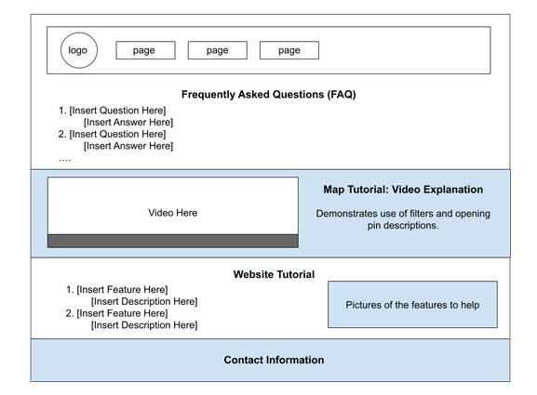
Isabella Stephens
SDD - Architecture Design [3.]
3.1 Program Structure
SDD - User Interfaces [4.3]
4.3.1 Home Screen
4.3.2 Contributor Page
4.3.3 Login
4.3.4 Sign Up
4.3.6 Profile Management
4.3.8 Help & Tutorial Page
4.3.9 Admin Page

Slide 20
Brittany Brenneman
Software Test Plan Document
Created the initial set up
Test Procedures
Section 2.1.1 Homepage
Map features
Project selection/logo/full screen features
Section 2.2.4 Administrator Features
Approval/rejection of projects

Slide 21
Yaro Kulchyckyj
STP Document:
Section 5 - Reporting and Corrective Actions
Section 7 - Test Procedures
STP Test Tracking Spreadsheet:
Created the excel spreadsheet to help keep track of testing for the STP document.
Kylie provided references which I iterated on to create the current testing format.
Added conditional formatting to better track testing progress
Marking a test as pass or fail will change the test row to a respective color of green or red
Created some example tests to be used a references
Created a test for SRS requirement 2.2.2.2

